Slide 1
Assessing sampling methods for generalization from RCTs: Modeling recruitment and participation
Gleb Furman and James E. Pustejovsky
University of Texas at Austin

Slide 2
Generalizability
Subset of external validity
Can we extrapolate the estimated average treatment effect (ATE) to units or sites outside of the sample?
Representativeness

Slide 3
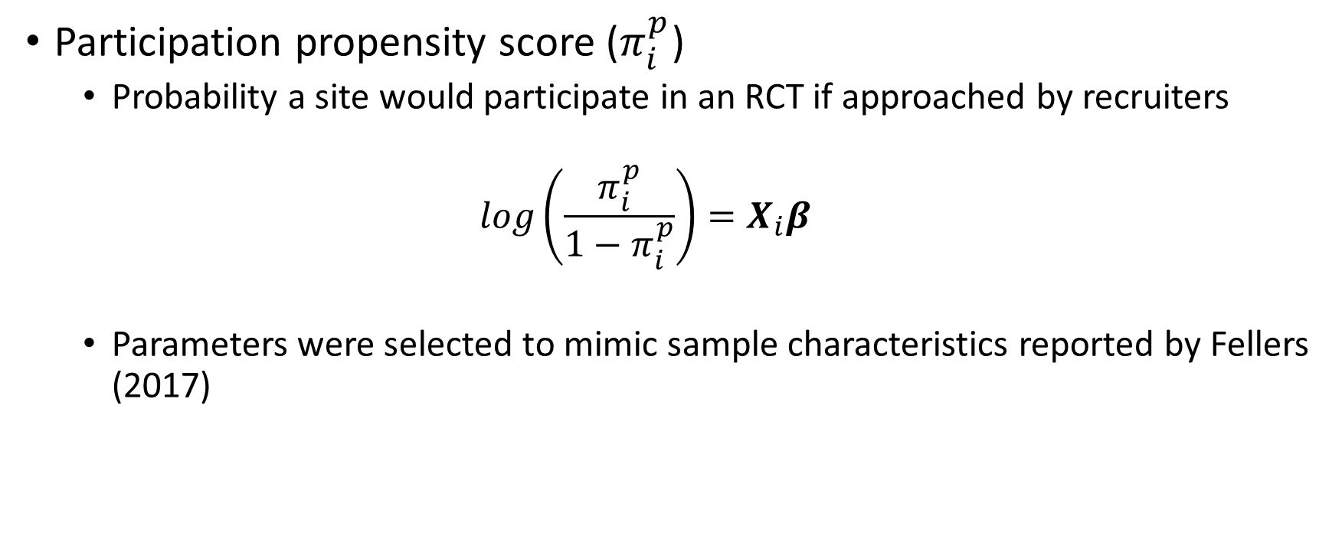
Participation Model
Participation propensity score ($π_{i}^{p}$)
Probability a site would participate in an RCT if approached by recruiters
$$log\left(\frac{π_{i}^{p}}{1−π_{i}^{p}}\right)=X_{i}β$$
Parameters were selected to mimic sample characteristics reported by Fellers (2017)
Notes:
One of our biggest challenges early on was to figure out how we would generate participation behavior.
We settled on generating a “propensity participation score” using a simple linear transformation of covariates with a logit link.
To select parameters for the model we

